Slide 1

Enhanced Shadow Removal for Surveillance Systems
Jishnu P
CB.EN.P2AID19017
M Tech (AID) 2019 - 2021 Batch
Guided By:
Dr. Rajathilagam B
Associate Professor
Department of Computer Science and Engineering

Slide 2
contents
Abstract
Problem Statement
Motivation
Dataset
Literature Survey
Challenges
GAN Architecture
Proposed Architecture
Tools/ Methods for implementation
References

Slide 3
Abstract
Shadow detection and removal is an important task when dealing with outdoor images.
Shadows always trouble computer vision tasks like visual navigation, object detection and tracking.
The field of shadow detection greatly improved compared to the shadow removal task
To tackle the adverse effect caused by shadows , the focus is on modified Generative Adversarial Network (GAN) which can effectively remove the shadow.

Slide 4
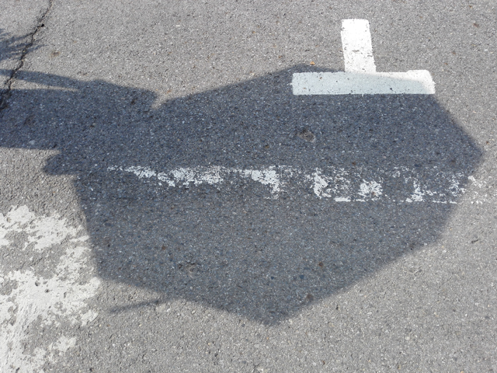
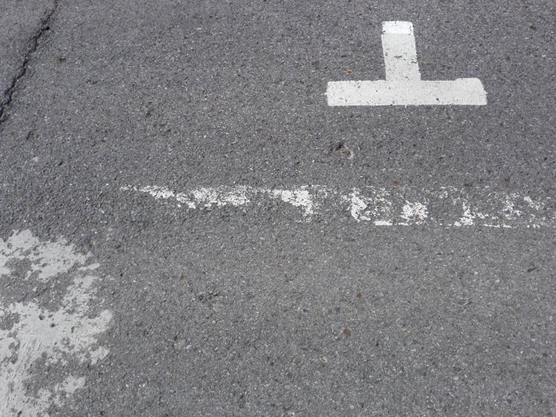
PROblem statement
To propose GAN based Shadow removal architecture which generates higher quality shadowless images
Shadowed
Shadowless

Slide 5
Motivation
After the introduction of Generative Adversarial Networks (GAN) in 2014[7], the computer vision domain has taken leap at various tasks.
Shadow removal is an important task which can be considered as an important preprocessing step for higher level Computer Vision tasks in surveillance systems.
The shadow detection phase has greatly improved , but the field of shadow removal has been difficult because it needs to be restored after removing the shadow.
To the extent to my knowledge, the shadow removal part is open to further improvements eventhough there are papers which employs GANs for the same.

Slide 6
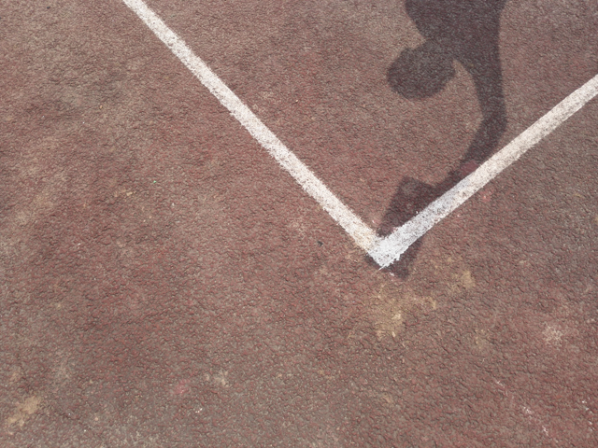

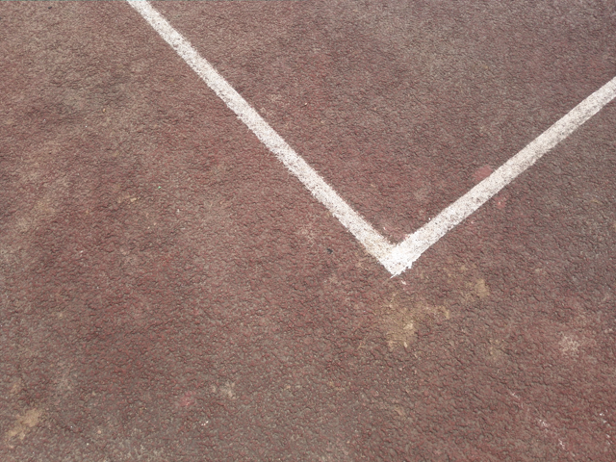
DATASET
ISTD Shadow removal benchmark dataset[1]
Dataset contains shadowed images, shadow mask, shadowless images
Train data - 1330 images (640 * 480 pixels)
Test data - 540 images
shadowed
shadow mask
shadowless

Slide 7
literature survey
Title | Techniques | Results (RMSE) | Year | Limitations
“Stacked Conditional Generative Adversarial Networks for Jointly Learning Shadow Detection and Shadow Removal”[1] | Introduced an architecture which contains two CGANs stacked together and which performs shadow detection and removal simultaneously | 7.47 (ISTD) | IEEE Xplore 2020 | High RMSE value, Not preserving information regarding local patches
“RIS-GAN: Explore Residual and Illumination with Generative Adversarial Networks for Shadow Removal"[2] | proposed a complex architecture which contain 4 generators and 3 discriminators and not using any shadow aware components for shadow removal. | 6.95 (ISTD) 6.78 (SRD) | AAAI 2020 | Architecture is complex and computationaly expensive

Slide 8
literature survey
Title | Techniques | Results | Year | Limitation
“DeshadowNet: A Multi-context Embedding Deep Network for Shadow Removal ”[3] | Implemented multi context by jointly training three networks G-Net, S-Net, A-Net. All togather called DeshadowNet | RMSE 6.64 (SRD dataset) | IEEE Conference 2017 | Image quality , blurred effect on shadowed reigon
“Conditional GANs for Multi-Illuminant Color Constancy: Revolution or Yet Another Approach?”[4] | Proposed AngularGan architecture to improve the color constancy on the images. | PSNR 21 (GTAV dataset) | CVPR 2018 | Model trained on synthetic data, results will vary for realistic images

Slide 9
literature survey
Title | Techniques | Results | Year | Limitations
"Shadow Detection and Removal for Illumination Consistency on the Road"[5] | Showed promising results for shadow detection using non-linear SVM classifier. | Accuracy 83% (UCF dataset) | 2020 IEEE trsaction | Poorly removing large shadows
“Shadow Detection and Removal From Photo-Realistic Synthetic Urban Image Using Deep Learning”[6] | Introduced GAN for shadow removal as an extension to the previous work and improved the performance. | RMSE 5.03 (Synthetic data generated) | 2019 CMC | Model Trained on synthetic, small size dataset

Slide 10
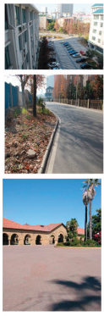
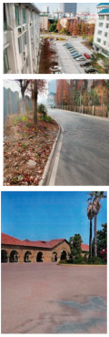
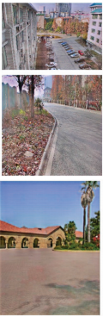
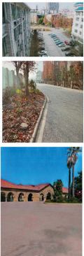
challenges
Explore existing GAN models and find out areas for improvements.
Ensuring the higher quality in shadowless image by using efficient evaluation metric and enhanced architecture.
Shadowed image
DeshadowNet
ST-GAN
RIS-GAN
Results of existing models[2]

Slide 11
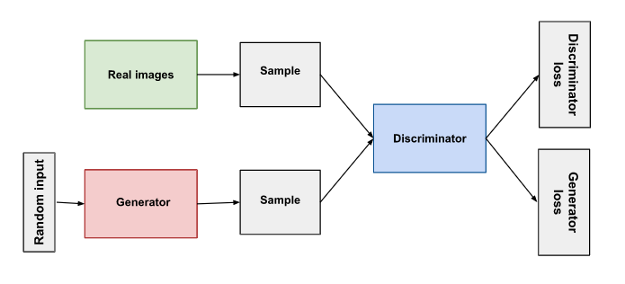
GAN architecture
https://developers.google.com/machine-learning/gan/gan_structure

Slide 12
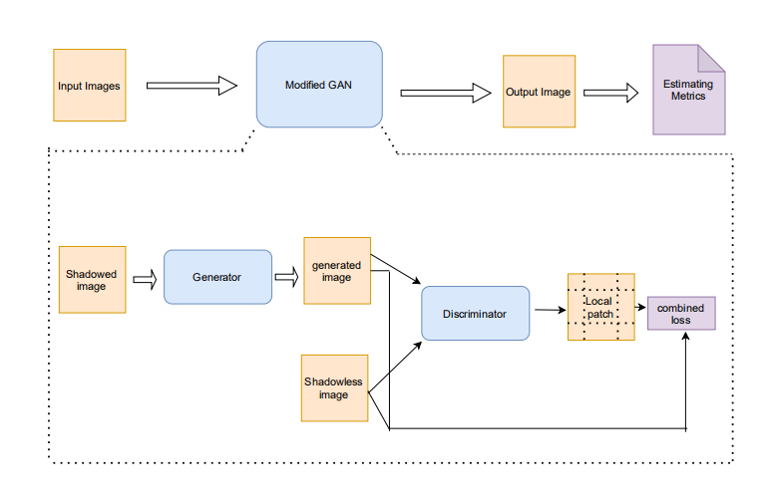
Proposed Architecture
Fake image
Fake image
Real Image
figure : proposed Architecture

Slide 13
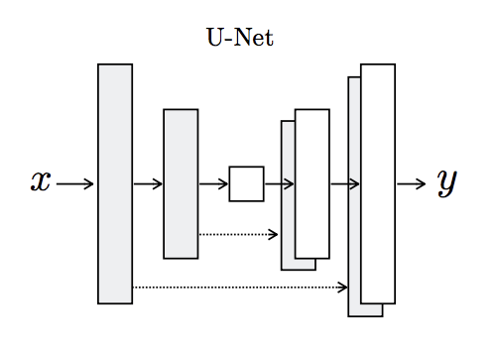
proposed architecture
The generator is an encoder-decoder model using a U-Net architecture.
The encoder and decoder of the generator contains convolutional, batch normalization, dropout, and activation layers.
Source : https://arxiv.org/abs/1505.04597

Slide 14
proposed architecture
The discriminator is a deep convolutional neural network that performs image classification.
It takes both the source image (generated image) and the target image (shadow-less image) as input and predicts the likelihood of whether shadow-less image is real or a fake translation of the generated image.
The discriminator model is trained in the same way as a traditional GAN model.

Slide 15
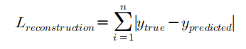
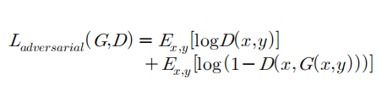
proposed architecture
Combined loss = λ1 * reconstruction loss + λ2 * adversarial loss
The reconstruction loss is the loss function between the generated fake image and the shadow-less image
Adversarial loss (Binary Cross Entropy loss)
x - shadowless image
y - shadowed image

Slide 16
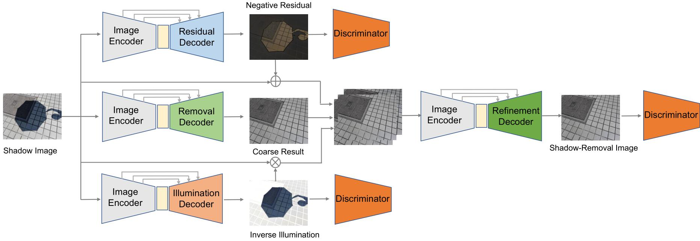
standard algorithm for comparison
RIS-GAN[2]
fig : Architecture of RIS - GAN[2]

Slide 17
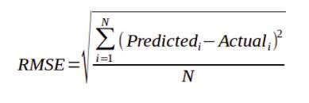
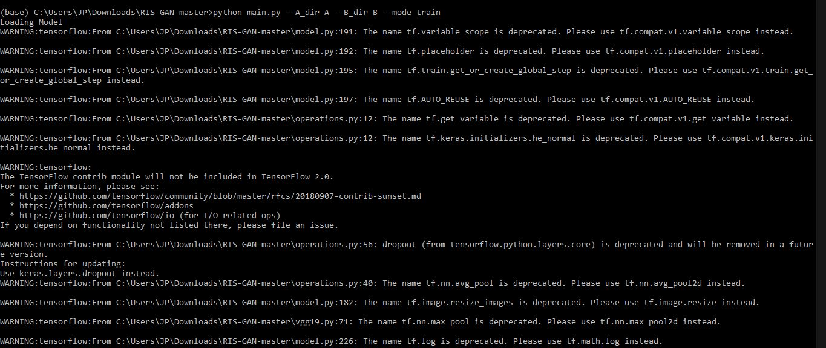
standard algorithm for comparison
RMSE(Root Mean Square Error) is used as the evaluation metric in RIS-GAN.
predictedi = The predicted value for the ith observation.
Actuali = The observed(actual) value for the ith observation
N = Total number of observations.

Slide 18
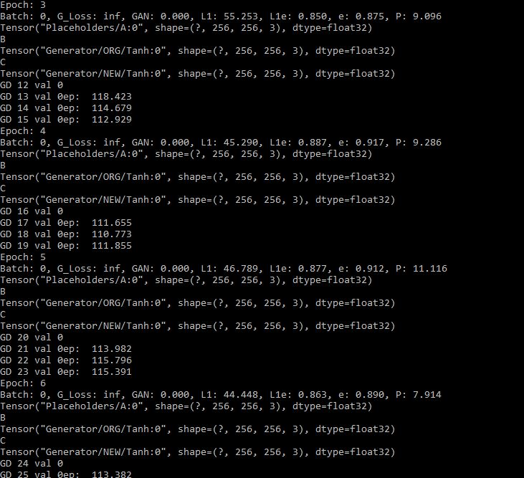
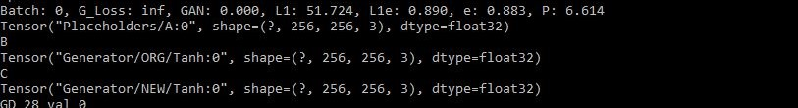
standard algorithm for comparison

Slide 19
Tools/ Methods for implementation
Programming Language -python 3.8
Numerical computation - Tensorflow 2.3.0,Numpy 1.19.x
Visualisation tools - Matplotlib 3.3.2, Seaborn 0.11, Scikit-Image

Slide 20
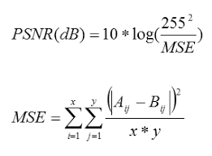
standard metrics for evaluation
Following metrics will be used for the evaluation of our model
RMSE
PSNR(peak signal-to-noise ratio)
This ratio is used as a quality measurement between the original and a compressed image. The higher the PSNR, the better the quality of the compressed or reconstructed image.

Slide 21
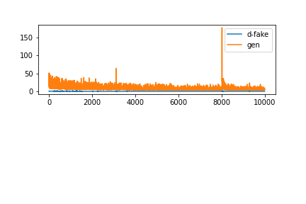
REsults
Generator & Discriminator loss curve
Loss
Epochs

Slide 22
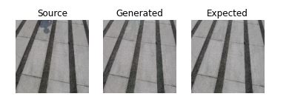
RESULTS
PSNR = 79.13db
RMSE = 0.048

Slide 23
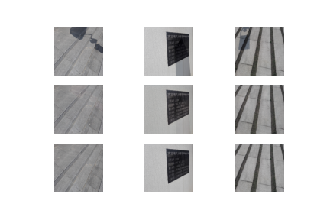
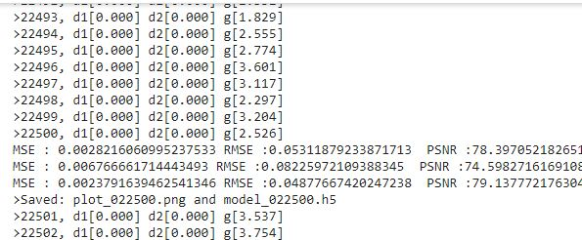
results
figure : source, generated, expected images are arranged row wise

Slide 24
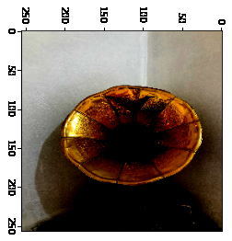
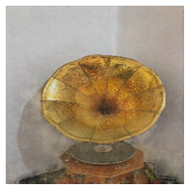
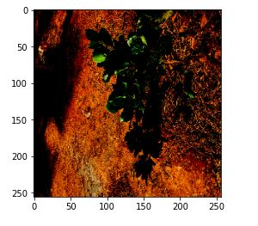
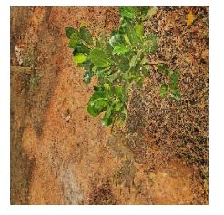
RESULTS
a
b
c
d
Figure : proposed model output on indoor and outdoor shadowed image samples. a,c are shadowed images and b,d are the output images of our model

Slide 25
future work
Performance analysis of the proposed model on SRD dataset.
Evaluate the model by using SSIM(Structural Similarity Index) metric.

Slide 26
References
[1]Jifeng Wang, Xiang Li2, Jian Yang, “Stacked Conditional Generative Adversarial Networks for Jointly Learning Shadow Detection and Shadow Removal”, CVPR 2017
[2]Ling Zhang,1 Chengjiang Long,2∗ Xiaolong Zhang,1 Chunxia Xiao3, “RIS-GAN: Explore Residual and Illumination with Generative Adversarial Networks for Shadow Removal”, AAAI 2020
[3]L. Qu, J. Tian, S. He, Y. Tang and R. W. H. Lau, "DeshadowNet: A Multi-context Embedding Deep Network for Shadow Removal," IEEE Conference on Computer Vision and Pattern Recognition (CVPR) 2017
[4]Sidorov, Oleksii, “Conditional GANs for Multi-Illuminant Color Constancy: Revolution or Yet Another Approach?”,The IEEE Conference on Computer Vision and Pattern Recognition (CVPR) 2018
[5]Wang, H. Xu, Z. Zhou, L. Deng and M. Yang, "Shadow Detection and Removal for Illumination Consistency on the Road," in IEEE Transactions on Intelligent Vehicles, 2020

Slide 27
references
[6]Yun, Heejin & Kang Jik, Kim & Chun, Jun-Chul. “Shadow Detection and Removal From Photo-Realistic Synthetic Urban Image Using Deep Learning”, Computers, Materials & Continua 2019
[7]Ian J. Goodfellow, Jean Pouget-Abadie, Mehdi Mirza, Bing Xu, David Warde-Farley, Sherjil Ozair, Aaron Courville, Yoshua Bengio, “Generative Adversarial Networks”, International Conference on Neural Information Processing Systems, 2014
C. Wang, L. Deng, Z. Zhou, M. Yang and B. Wang, "Shadow detection and removal for illumination consistency on the road," 2017 International Conference on Security, Pattern Analysis, and Cybernetics (SPAC), Shenzhen, 2017
J. M. Wang, Y. C. Chung, C. L. Chang and S. W. Chen, "Shadow detection and removal for traffic images," IEEE International Conference on Networking, Sensing and Control, 2004, Taipei, Taiwan, 2004
Xiaodong Cun, Chi-Man Pun, Cheng Shi, “ Towards Ghost-free Shadow Removal via Dual Hierarchical Aggregation Network and Shadow Matting GAN” AAAI 2020

Slide 28
References
https://machinelearningmastery.com/generative_adversarial_networks/
https://medium.com/@jonathan_hui/gan-gan-series-2d279f906e7b
https://theaisummer.com/gan-computer-vision/
https://www.geeksforgeeks.org/modal-collapse-in-gans/

Slide 29
THANK YOU

Slide 30
